Slide 1
Office 365 Development
July 2014

Slide 2

Meet Jeremy Thake | @jthake
Jeremy recently joined Microsoft as Technical Product Manager for the Visual Studio Developer story for Office 365 development
He has been heavily involved in the SharePoint community since 2006
SharePoint MVP award 4 years in a row
Chief Architect shipping two Apps to the Office Store

Slide 3

Meet Brian Jones | @jones206
Brian Group Program Manager of the Office Developer Platform team
He has spent the past 14 years working on various pieces of the Office and SharePoint products
Word extensibility
Office Open XML file formats
Cross product app model

Slide 4
Course Agenda
Introduction to Office 365 Development
Module 1: Overview of Office 365 Development
Module 2: Getting started with Apps for Office
Module 3: Getting started with Apps for SharePoint
Module 4: Getting started with the Office 365 APIs
Module 5: Getting started with Mobile development with Office 365
Module 6: Moving Full Trust Code to the Cloud Using Repeatable Patterns and Best Practices
Module 7: Setting up your Developer environment in Office 365
Module 8: Setting up your on-premises environment for app development

Slide 5
Getting started with the Office 365 APIs
Jeremy Thake
Technical Product Manager, Microsoft
Brian Jones
Group Program Manager, Microsoft

Slide 6
Agenda
Intro to the Office 365 APIs
Getting started
Demos
Notes:
What new APIs are available, in preview, in the Office 365 Platform
How to use these API’s in your platform of choice
Some sample business scenarios for leveraging these API’s
Level: Intermediate
Audience: Developer Essentials

Slide 7
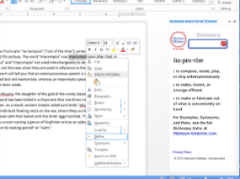
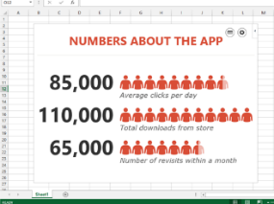
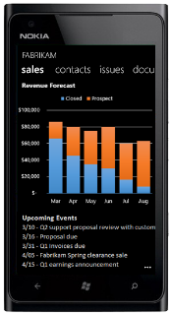
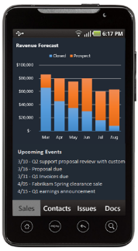
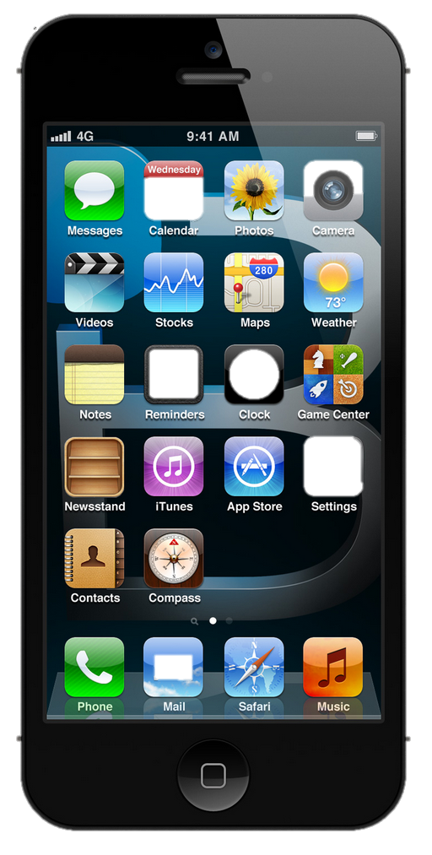
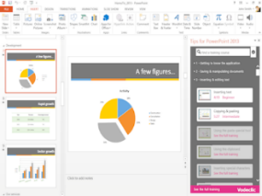
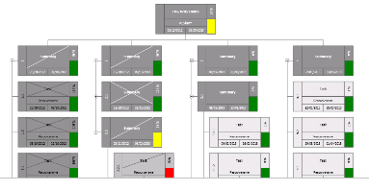


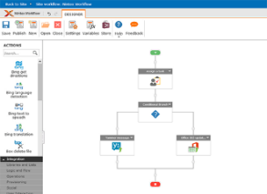



The new Office development platform
Contextual apps
Robust APIs
Flexible tools
iOS
Documents
Search
Mail
Social
Calendar
People
Notes:
Two kinds of apps :
you light up Office/Exchange/SharePoint.
You consume our services in a custom (device or web) app
Contextual apps
Rich, powerful interactive IW experiences
Do more, without leaving Excel, Outlook, PowerPoint, SharePoint
Consistent Framework everywhere that Office runs. Everywhere that people do work
Robust APIs
Big news
More for SharePoint Devs
Growing up outside SharePoint
Flexible Tools
Open-ness and choice is a core pillar
But … we just want to take away all the friction
Tools targeted to specific users
Platforms with best management, capability and scale
What does this mean. Where is the value
Breadth : more endpoints and experiences
Depth: richer APIs. More capabilities
Power:

Slide 8
Intro to the Office 365 APIs

Slide 9
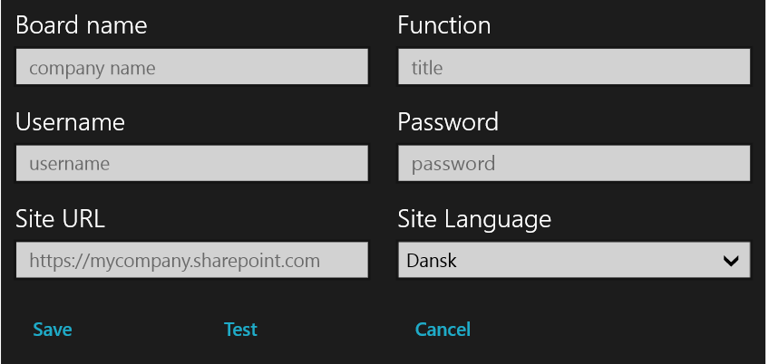
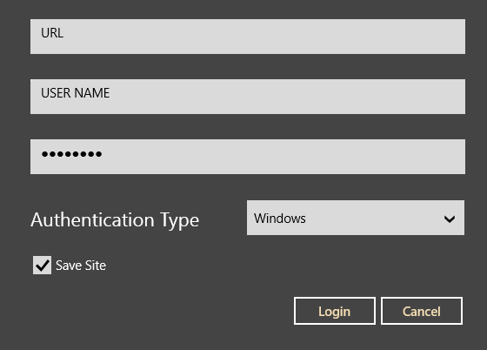
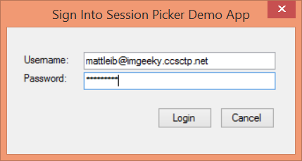
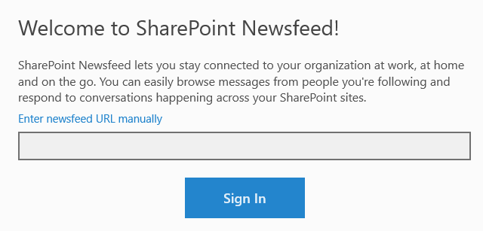
Office 365 device apps

Slide 10
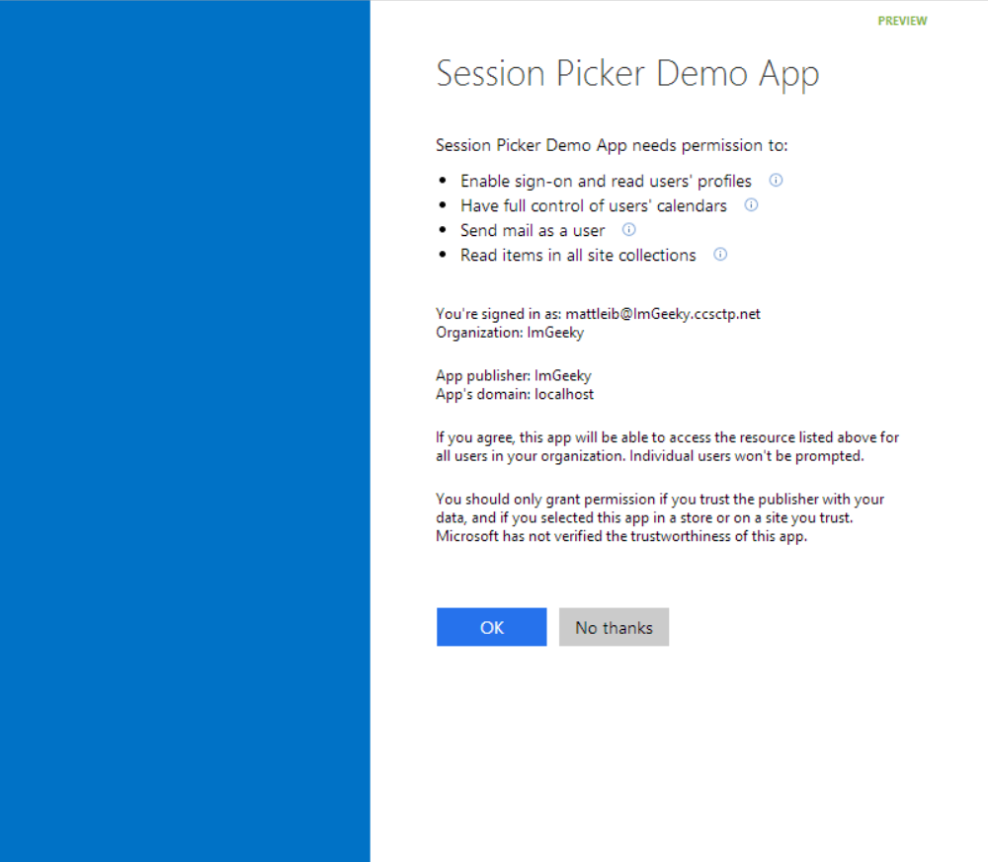
Common consent

Slide 11
Single authentication flow for Office 365
Azure AD graph, Exchange, SharePoint,…
Device apps and standalone websites
Admin and end-user consent

Slide 12
Secure protocol
OAuth 2.0
No capturing user credentials
Fine-grained access scopes
Supports MFA and federated user sign-in
Long-term access through refresh tokens

Slide 13
Office 365 discovery services
Automatically determine URL of O365 services
Supports device app and website flows
Secured using Azure AD authentication
Serves information stored about services in AAD

Slide 14
The SharePoint client APIs
Sites, Lists and Libs
Workflow
Search
Taxonomy
BCS
…
_api
Execute query
REST/ OData
JavaScript library
Silverlight library
.Net CLR library
Custom client code

Slide 15
Office 365 APIs Roadmap
Active Directory
Exchange & Outlook.com
SharePoint
OneDrive
Sites
OneDrive
Users
Mail
Calendar
Client API
OneDrive for Business
Sites, Lists and Libs
Taxonomy
Groups
Contacts
Workflow
BCS
Search
…

Slide 16
Getting Started

Slide 17
http://aka.ms/o365apis

Slide 18
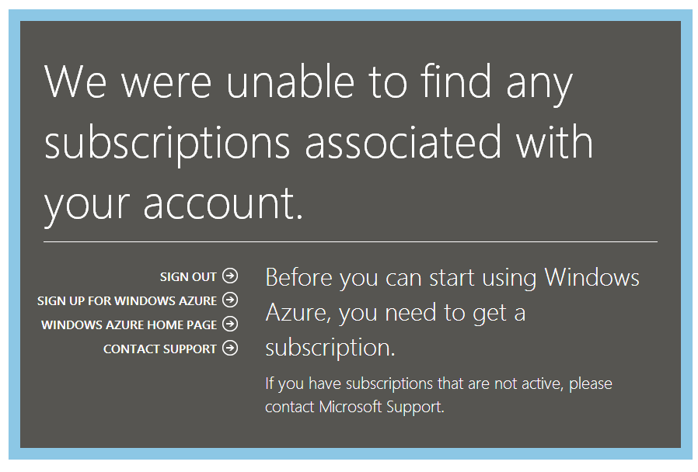

Slide 19
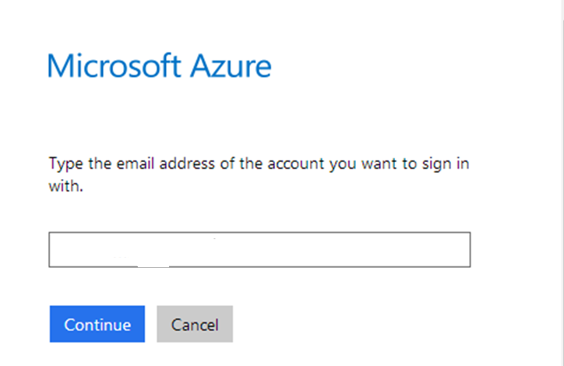

Slide 20
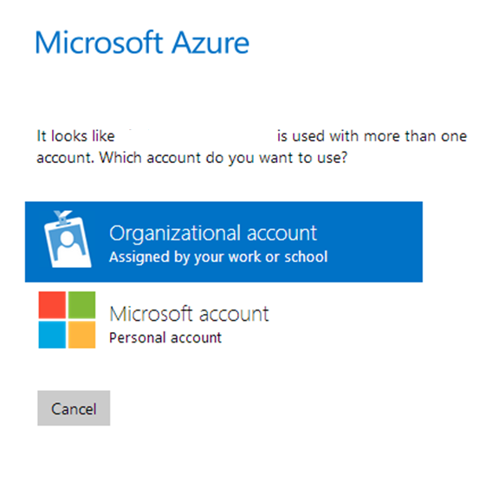

Slide 21
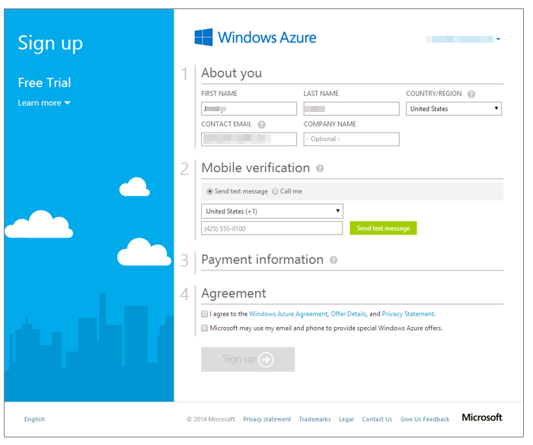

Slide 22
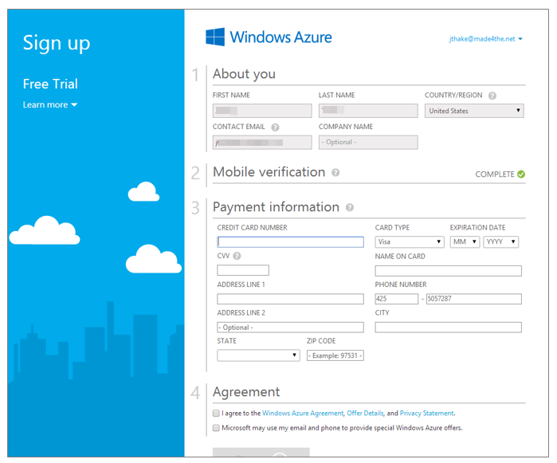

Slide 23
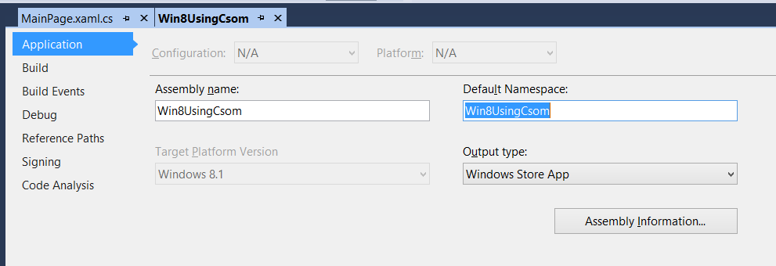

Slide 24
demo
Azure Active Directory portal

Slide 25
demo
Authentication process
Notes:
Use demo sample from MSDN Code Gallery http://code.msdn.microsoft.com/Office-365-APIs-How-to-use-609102ea

Slide 26
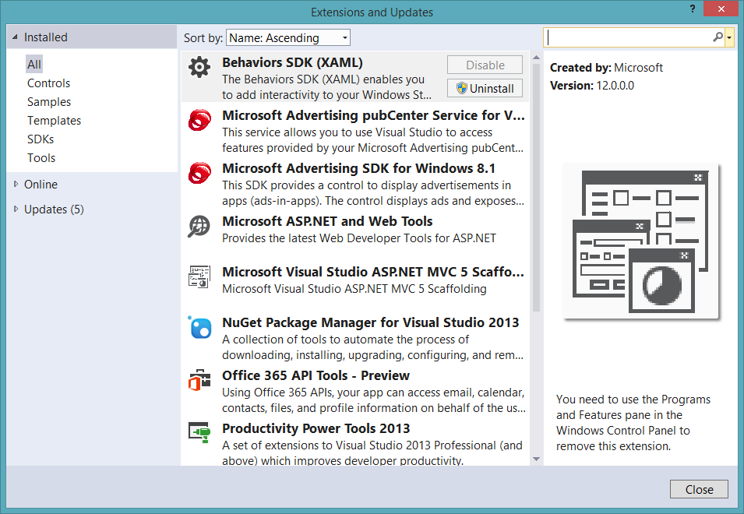
Get the tools

Slide 27
Visual Studio project support
.NET Windows Store Apps
Windows Forms Application
WPF Application
ASP.NET MVC Web Application
ASP.NET Web Forms Application
Xamarin Android and iOS Applications
Multi-device Hybrid Apps (Cordova)

Slide 28
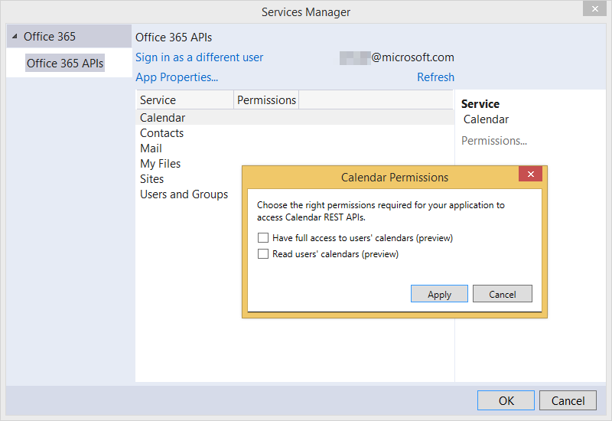

Slide 29
demo
Getting started Office 365 API tools for VS ASP.NET MVC

Slide 30
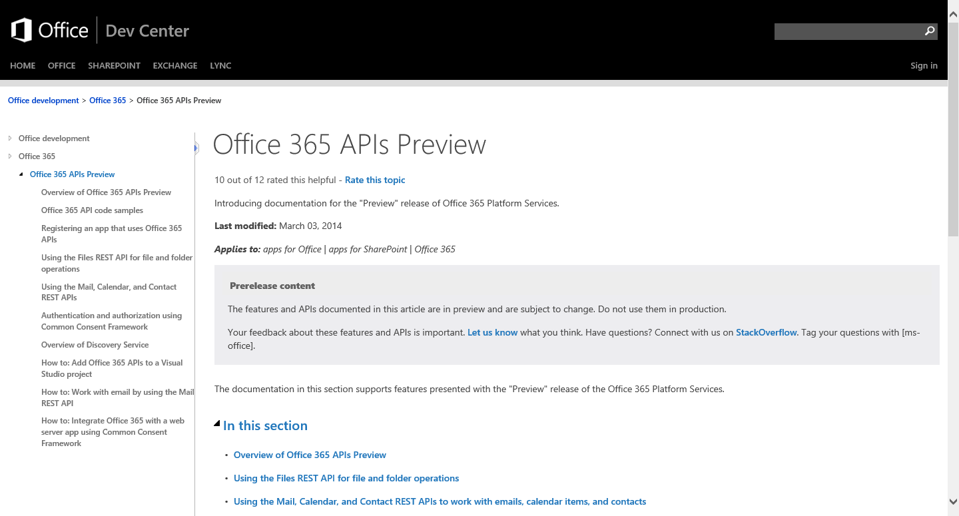
http://aka.ms/Office365DevAPIs

Slide 31
Demos

Slide 32
demo
ASP.NET MVC project demo
Notes:
SharePoint Power Hour O365aPI Full Stack demo https://github.com/OfficeDev/SharePoint-Power-Hour-Code-Samples/tree/master/O365ApiFullStack

Slide 33
demo
AngularJS HTML/JS project demo
Notes:
Research Project

Slide 34
Conclusion
New way of calling Office 365 Services
Available in preview today
Great samples available

Slide 35
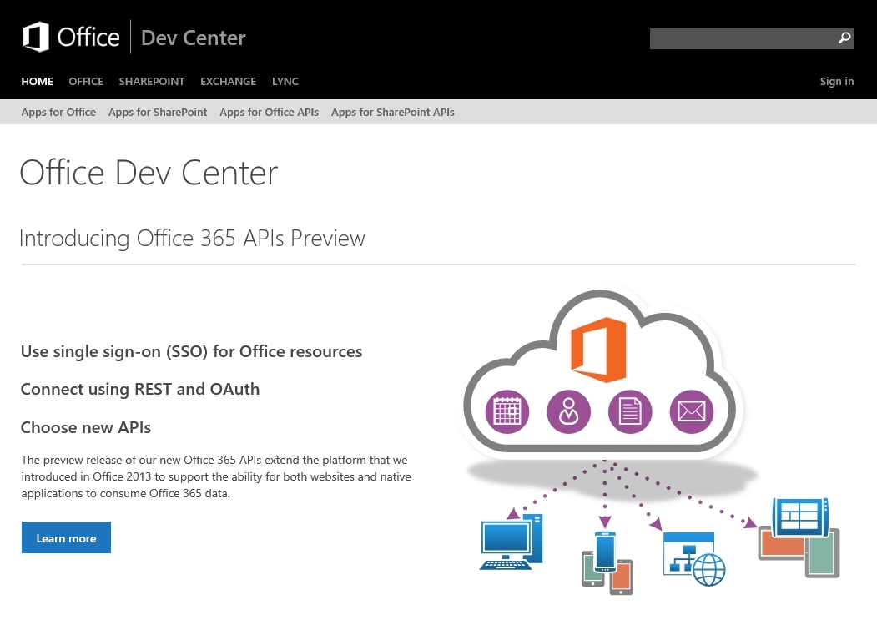
Dev.
Office
.com
One stop shop for Office Developer Platform

Slide 36


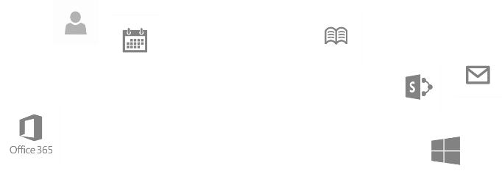
Calls to action
Explore our MSDN library
http://dev.office.com
Play with our code samples
http://aka.ms/OfficeDevSamples
Follow our patterns & practices
http://aka.ms/OfficeDevPnP
Get answers
http://aka.ms/AskSharePoint
http://aka.ms/AskOffice
Give feedback Drive our roadmap http://aka.ms/OfficeDevFeedback

Slide 37
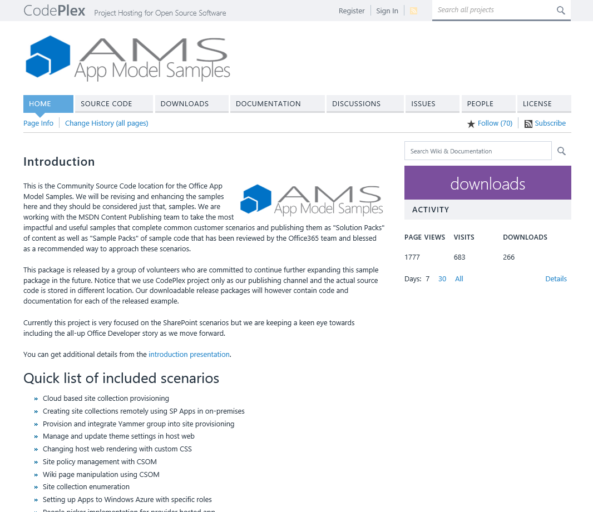
aka.ms/OfficeAMS
Patterns and practices
Providing App Model Patterns for common Full Trust Code scenarios
30+ Visual Studio projects Common scenarios
Branding
Site provisioning
Remote event receivers
Large file support
Taxonomy driven navigation
And much more…
Contribute
Open source coming soon!

